Slide 1


AccesAI: Enhancing Web Accessibility with AI
Introducing AccesAI, an AI-powered tool revolutionizing web accessibility.
by Divyansh Rastogi

Slide 2
The Accessibility Challenge
Missing Alt Text
Unclear Labels
Poor Contrast
Navigation Issues
Images lack descriptive text for screen readers
Confusing or missing labels on interactive elements
Difficult for users with visual impairments to see
Website structure is not easily understood

Slide 3

The AccesAI Solution
1
Analyze
2
Detect
Automated detection of accessibility issues
Pinpointing specific accessibility violations
3
Auto-Fix
4
Visually Validate
Automatic suggestions for fixing issues
Previewing changes to ensure visual accessibility

Slide 4





Powering AccesAI
AI
Computer Vision
Web Scraping
Few-Shot Learning
Leveraging machine learning for intelligent analysis
Analyzing images and videos for visual accessibility
Extracting data from websites for accessibility analysis
Efficiently training AI models with limited data

Slide 5

AccesAI Features
Real-Time Fixes
Manual Tweaks
Instantaneous suggestions as users browse
Customization options for fine-tuning results
User-Friendly Interface
Intuitive design for easy accessibility testing

Slide 6
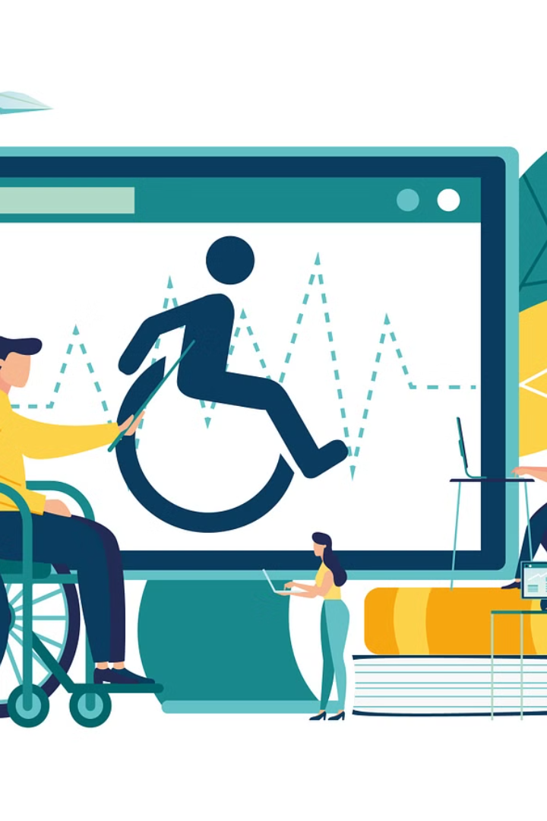
Impact of AccesAI
1
Inclusive Web
Ensuring websites are usable by everyone
2
Accessibility Compliance
Meeting legal requirements for accessibility standards
3
Enhanced UX
Improved user experience for all users
4
Developer Efficiency
Streamlining the accessibility testing process

Slide 7




Bringing Accessibility to the Forefront
Raising Awareness
Promoting accessibility best practices
Empowering Developers
Providing tools to create accessible websites
Creating Change
Building a more inclusive online world

Slide 8

The Future of Accessible Web Experiences
AccesAI paves the way for a future where the web is truly accessible to all.

